Slide 1
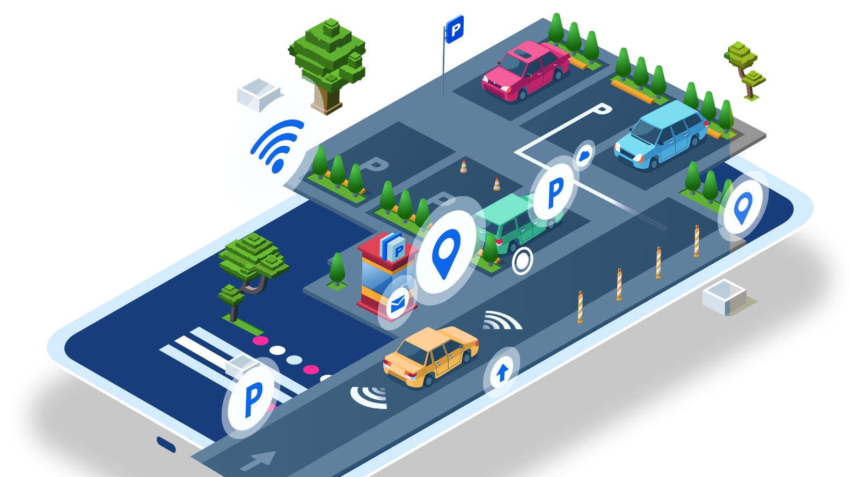
SmartPark
IoT based Parking Solution!!

Slide 2

Problem Statement
Parking has always been an issue in the metropolitan cities.
It wastes time, fuel, and causes stress.
Circling for spots increases traffic congestion, fuel wastage, and pollution.
To overcome this, we are designing:
A low-cost system that will use Raspberry Pi and ESP32 CAM Module for detecting and updating the user real-time parking spots through a mobile app or webpage.
This system is compact, cost-effective and can be installed at any parking location.

Slide 3
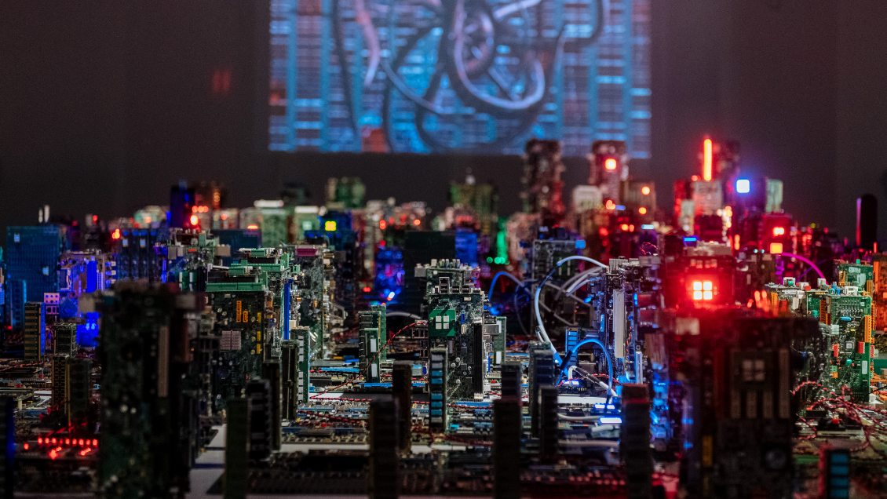
System components
1. Raspberry Pi
Acts as a decentralized server and handles image processing, computation and network management.
2. ESP32 CAM
For taking images and sending it to Raspberry Pi.
3. 5V Power Supply

Slide 4
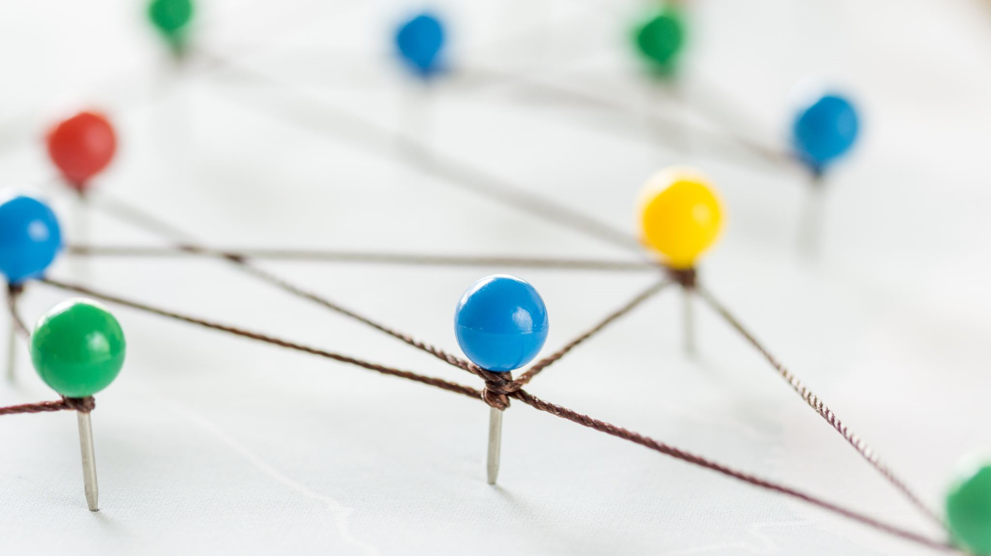
interaction
ESP Modules & Image Capture: ESP modules with cameras capture images of the parking lot, transmitting them to the Raspberry Pi.
Raspberry Pi & TensorFlow Lite: The Raspberry Pi processes the images using TensorFlow Lite, a lightweight solution optimized for edge devices, to determine parking slot availability and generate timestamps.
Data Transmission to AWS EC2: Processed parking data, including slot status and timestamps, is sent from the Raspberry Pi to an AWS EC2 instance.
AWS EC2 & Database Management: The EC2 instance manages and stores the parking data in a database hosted on AWS , ensuring data integrity and availability.
Web Application & User Interaction: Users interact with a Node.js web application to view real-time parking status and make reservations, with data served directly from the AWS-hosted database.
Real-Time Communication: WebSocket or MQTT protocols ensure that any updates in parking slot status are instantly reflected on the user interface.

Slide 5
interaction
ESP 32 Camera will capture the image and send it to Raspberry Pi via wireless connection or cable.
The Raspberry Pi will process the images using the ML Modeland determine parking slot availability.
This data will be published on a webpage using AWS server and the user will know if parking slot is available or not.

Slide 6

tradeoffs
Local vs. Cloud Processing: We process data directly on the device for low-latency responses, although this limits us compared to the more powerful cloud processing.
Database System Decision: We use a straightforward database to save on costs and setup time, accepting that we might need to upgrade later as our data grows.
Computational Constraints: Our Raspberry Pi has limited CPU and RAM, so we use less complex algorithms to ensure the system runs smoothly.

Slide 7
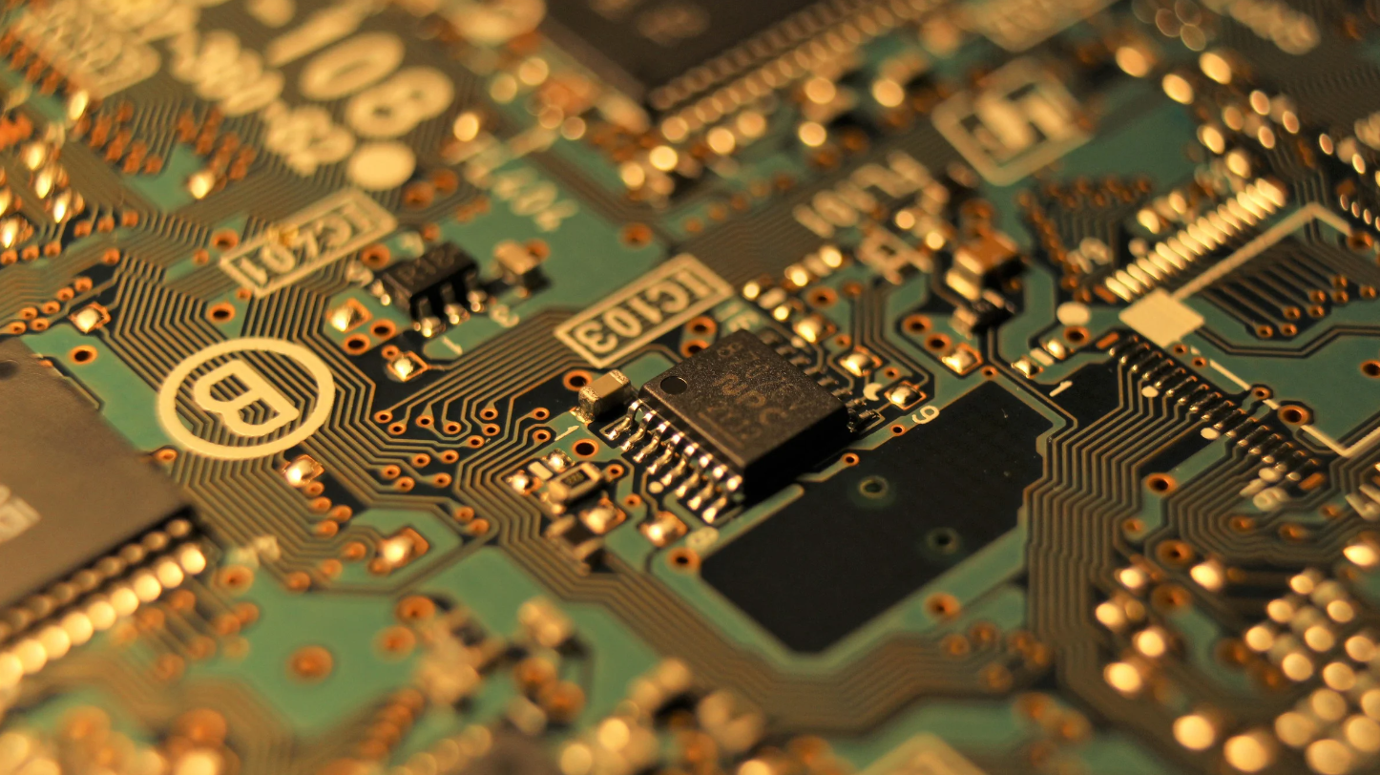
Tech stack
Hardware:
Raspberry Pi
ESP32 CAM Module
Software:
TensorFlow Lite/PyTorch: For on-device machine learning and image processing.
HTML/CSS/JavaScript: Builds and styles the web application’s user interface.
WebSocket/MQTT: Ensures real-time updates between server and client.
Arduino IDE: Programs Arduino-based hardware. GitHub: Manages version control and collaborative development.
Cloud Services & Databases:
AWS (Amazon Web Services): Hosts, scales, and manages the application and database.

Slide 8

challenges
Accurate Vehicle Detection:
Striving for high accuracy with simpler algorithms on the Raspberry Pi.
Cloud Integration:
Maintaining a stable, real-time connection with the cloud, balancing data processing demands and system stability.
Lighting and Environment:
Adapting image processing to diverse lighting and weather conditions to preserve detection accuracy.
Connectivity and Latency:
Ensuring consistent data flow between the ESP32-CAM, Raspberry Pi, and cloud, minimizing delays and data loss.

Slide 9
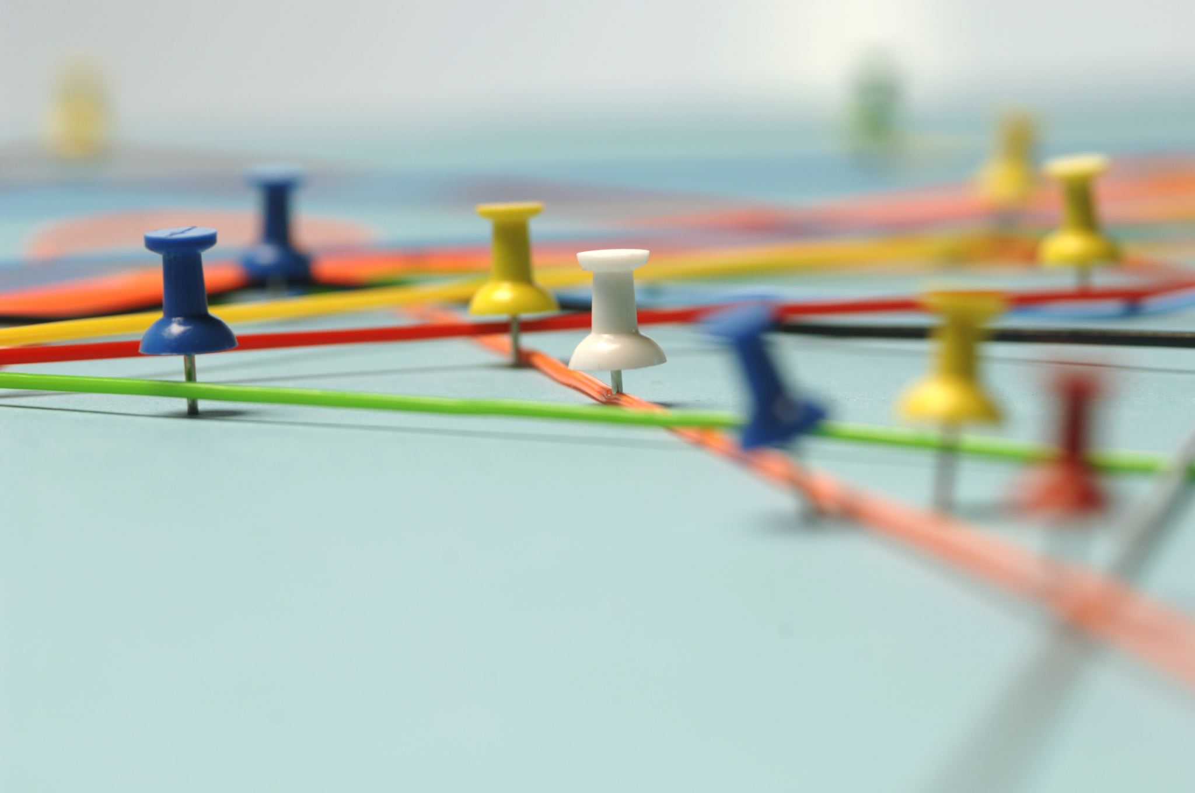
timeline
Week 1 – Hardware Setup
Week 2 – Object Detection
Week 3 – Integration and Cloud setup
Week 4 – Testing, Refinement and Documentation

Slide 10
Questions and suggestions?

